Slide 1
Physical Interface Design
MED4 - Mini project
Kristinn Bragi Garðarsson
Malte Elkær Rasmussen

Slide 2
Initial Idea
Musical instrument
Inspiration from accordion

Slide 3
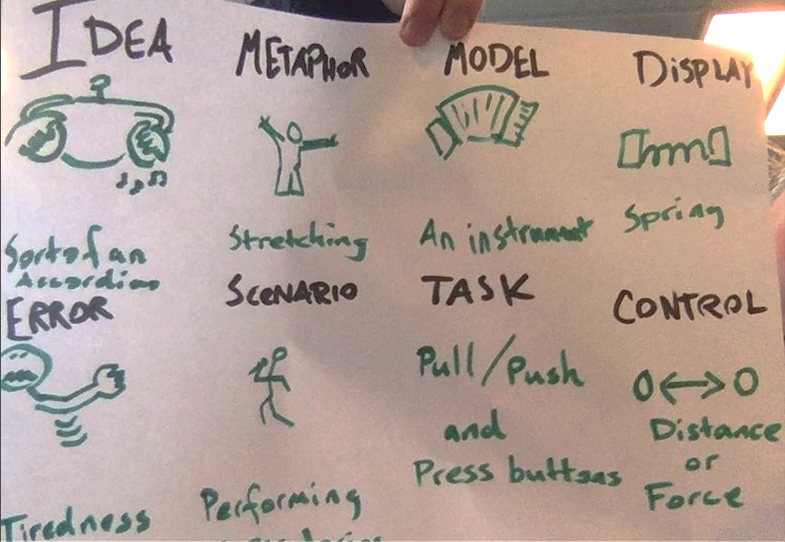

Slide 4
Glove controller
Arduino Uno
Flex sensors
Accelerometer

Slide 5
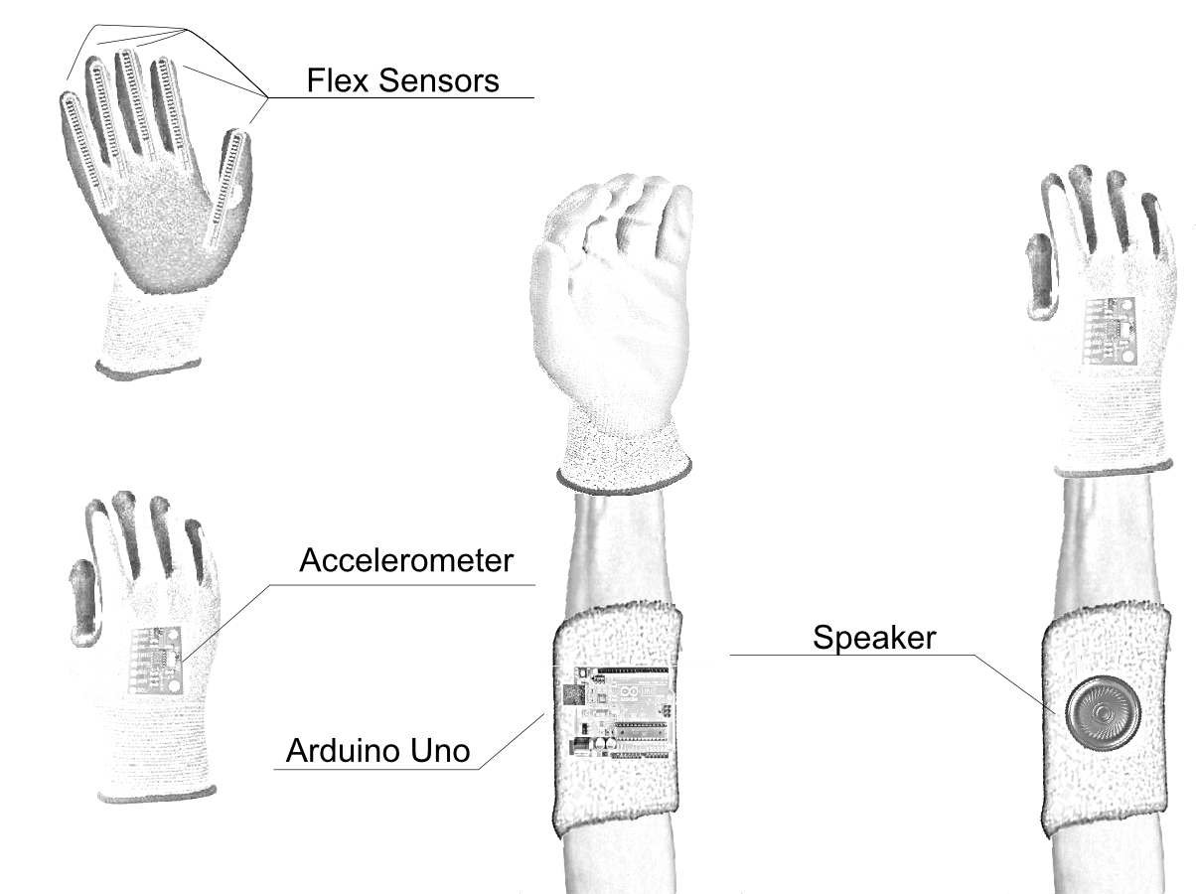

Slide 6
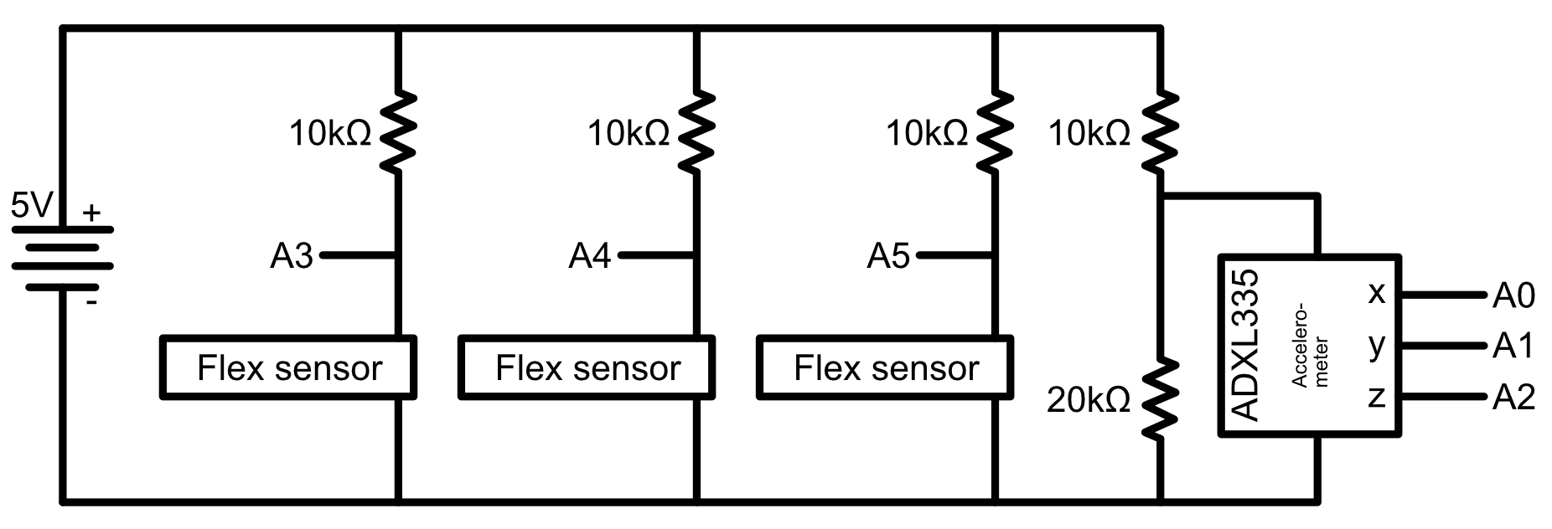
Schematic diagram

Slide 7
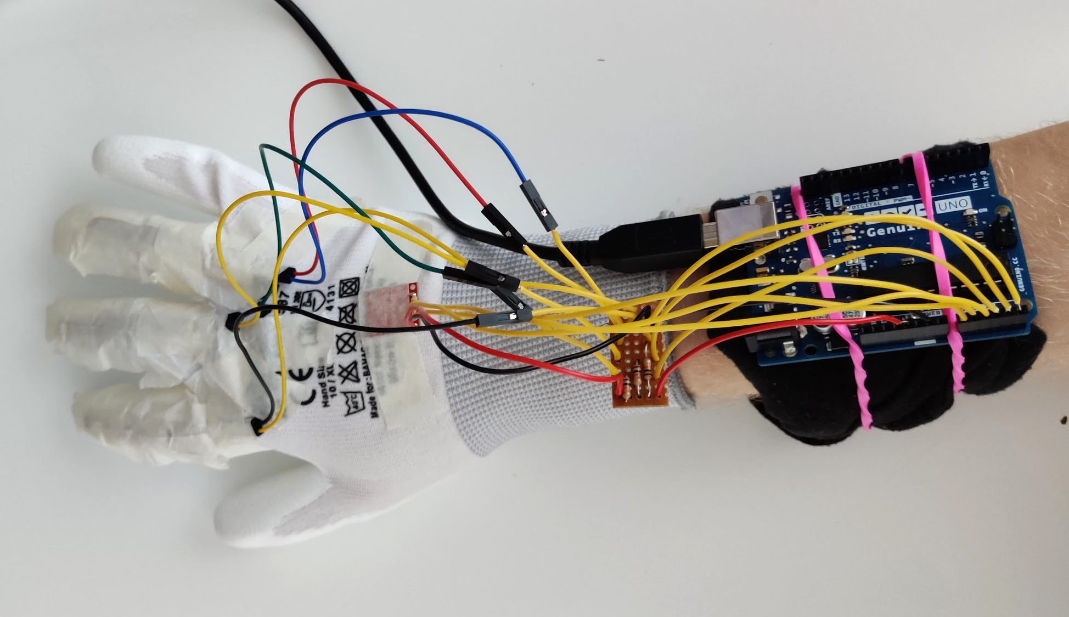

Slide 8
Software
Fingerings
Tilting
Shaking

Slide 9
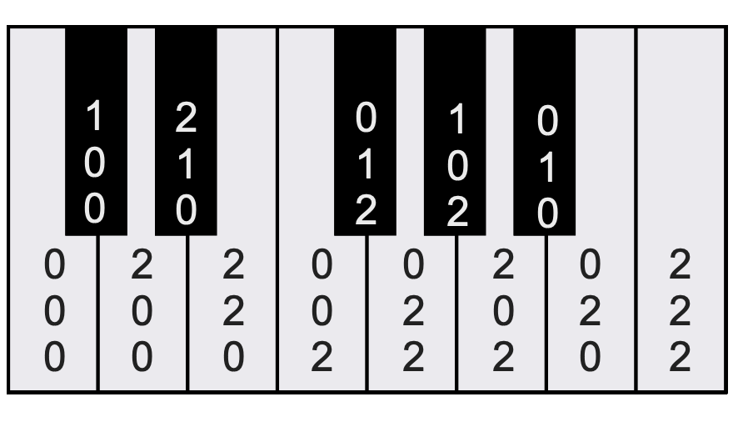
Fingerings

Slide 10
Conclusion
Consistency problem
Flick for octave change
Effects controls

